Slide 1
Artificial Neural Networks

Slide 2
Introduction
Artificial Neural Networks (ANN)
  Information processing paradigm inspired by biological nervous systems
  ANN is composed of a system of neurons connected by synapses
  ANN learn by example
    Adjust synaptic connections between neurons

Slide 3
History
1943: McCulloch and Pitts model neural networks based on their understanding of neurology.
  Neurons embed simple logic functions:
    a or b
    a and b
1950s:
  Farley and Clark
    IBM group that tries to model biological behavior
    Consult neuro-scientists at McGill, whenever stuck
  Rochester, Holland, Haibit and Duda

Slide 4
History
Perceptron (Rosenblatt 1958)
  Three layer system:
    Input nodes
    Output node
    Association layer
  Can learn to connect or associate a given input to a random output unit
Minsky and Papert
  Showed that a single layer perceptron cannot learn the XOR of two binary inputs
  Lead to loss of interest (and funding) in the field

Slide 5
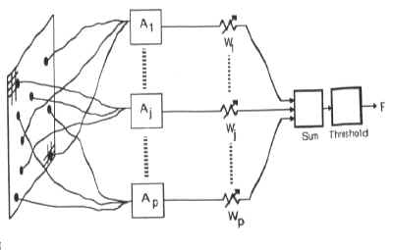
History
Perceptron (Rosenblatt 1958)
  Association units A₁, A₂, … extract features from user input
  Output is weighted and associated
  Function fires if weighted sum of input exceeds a threshold.

Slide 6
History
Back-propagation learning method (Werbos 1974)
  Three layers of neurons
    Input, Output, Hidden
  Better learning rule for generic three layer networks
  Regenerates interest in the 1980s
Successful applications in medicine, marketing, risk management, … (1990)
In need for another breakthrough.

Slide 7
ANN
Promises
  Combine speed of silicon with proven success of carbon → artificial brains

Slide 8
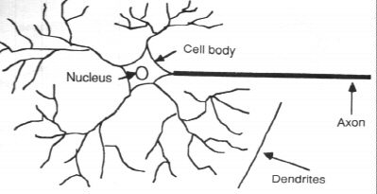
Neuron Model
Natural neurons

Slide 9
Neuron Model
Neuron collects signals from dendrites
Sends out spikes of electrical activity through an axon, which splits into thousands of branches.
At end of each brand, a synapses converts activity into either exciting or inhibiting activity of a dendrite at another neuron.
Neuron fires when exciting activity surpasses inhibitory activity
Learning changes the effectiveness of the synapses

Slide 10
Neuron Model
Natural neurons

Slide 11
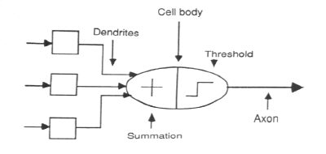
Neuron Model
Abstract neuron model:

Slide 12
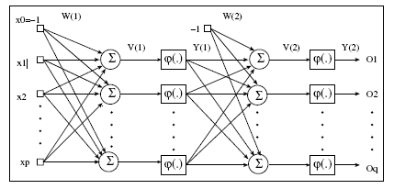
ANN Forward Propagation

Slide 13
ANN Forward Propagation
Bias Nodes
  Add one node to each layer that has constant output
Forward propagation
  Calculate from input layer to output layer
  For each neuron:
    Calculate weighted average of input
    Calculate activation function

Slide 14
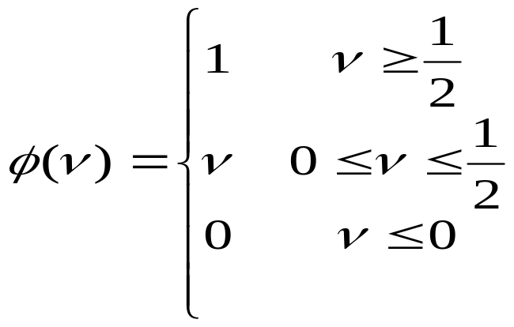
Neuron Model
Firing Rules:
  Threshold rules:
    Calculate weighted average of input
    Fire if larger than threshold
  Perceptron rule
    Calculate weighted average of input input
    Output activation level is

Slide 15
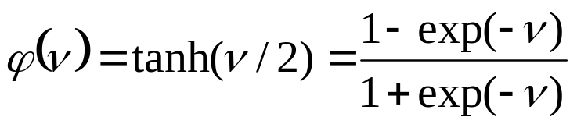
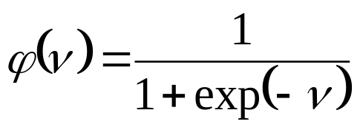
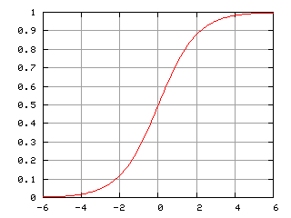
Neuron Model
Firing Rules: Sigmoid functions:
  Hyperbolic tangent function
  Logistic activation function

Slide 16
ANN Forward Propagation

Slide 17
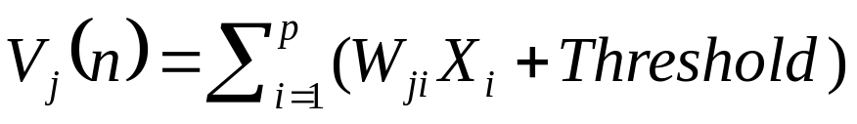
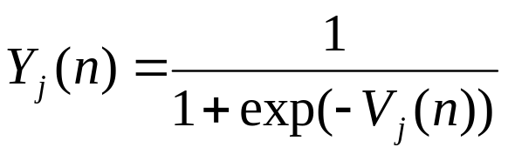
ANN Forward Propagation
Apply input vector X to layer of neurons.
Calculate
  where X_{i} is the activation of previous layer neuron i
  W_{ji} is the weight of going from node i to node j
  p is the number of neurons in the previous layer
Calculate output activation

Slide 18
ANN Forward Propagation
Example: ADALINE Neural Network
  Calculates and of inputs
0
w_{0,3}=.6
w_{1,3}=.6
threshold function is step function
1
3
2
w_{2,3}=-.9
Bias Node

Slide 19
ANN Forward Propagation
Example: Three layer network
  Calculates xor of inputs
-4.8
0
2
5.9
5.1
4
4.6
1
3
5.2
-5.2
-3.2
-2.6
-2.7
Bias

Slide 20
ANN Forward Propagation
Input (0,0)
-4.8
0
2
5.9
5.1
4
4.6
1
3
5.2
-5.2
-3.2
-2.6
-2.7
Bias

Slide 21
ANN Forward Propagation
Input (0,0)
  Node 2 activation is ϕ(-4.8 ⋅ 0+4.6 ⋅ 0 - 2.6)= 0.0691
-4.8
0
2
5.9
5.1
4
4.6
1
3
5.2
-5.2
-3.2
-2.6
-2.7
Bias

Slide 22
ANN Forward Propagation
Input (0,0)
  Node 3 activation is ϕ(5.1 ⋅ 0 - 5.2 ⋅ 0 - 3.2)= 0.0392
-4.8
0
2
5.9
5.1
4
4.6
1
3
5.2
-5.2
-3.2
-2.6
-2.7
Bias

Slide 23
ANN Forward Propagation
Input (0,0)
  Node 4 activation is ϕ(5.9 ⋅ 0.069 + 5.2 ⋅ 0.069 – 2.7)= 0.110227
-4.8
0
2
5.9
5.1
4
4.6
1
3
5.2
-5.2
-3.2
-2.6
-2.7
Bias

Slide 24
ANN Forward Propagation
Input (0,1)
  Node 2 activation is ϕ(4.6 -2.6)= 0.153269
-4.8
0
2
5.9
5.1
4
4.6
1
3
5.2
-5.2
-3.2
-2.6
-2.7
Bias

Slide 25
ANN Forward Propagation
Input (0,1)
  Node 3 activation is ϕ(-5.2 -3.2)= 0.000224817
-4.8
0
2
5.9
5.1
4
4.6
1
3
5.2
-5.2
-3.2
-2.6
-2.7
Bias

Slide 26
ANN Forward Propagation
Input (0,1)
  Node 4 activation is ϕ(5.9 ⋅ 0.153269 + 5.2 ⋅ 0.000224817 -2.7 )= 0.923992
-4.8
0
2
5.9
5.1
4
4.6
1
3
5.2
-5.2
-3.2
-2.6
-2.7
Bias

Slide 27
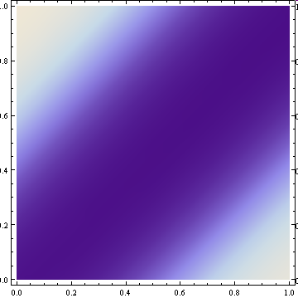
ANN Forward Propagation
Density Plot of Output

Slide 28
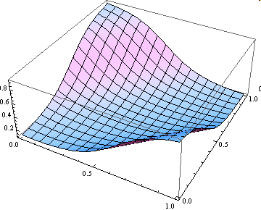
ANN Forward Propagation

Slide 29
ANN Forward Propagation
Network can learn a non-linearly separated set of outputs.
Need to map output (real value) into binary values.

Slide 30
ANN Training
Weights are determined by training
  Back-propagation:
    On given input, compare actual output to desired output.
    Adjust weights to output nodes.
    Work backwards through the various layers
  Start out with initial random weights
    Best to keep weights close to zero (<<10)

Slide 31
ANN Training
Weights are determined by training
  Need a training set
    Should be representative of the problem
  During each training epoch:
    Submit training set element as input
    Calculate the error for the output neurons
    Calculate average error during epoch
    Adjust weights

Slide 32
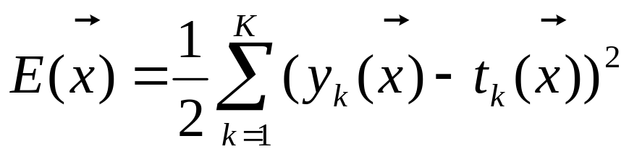
ANN Training
Error is the mean square of differences in output layer
y – observed output
t – target output

Slide 33
ANN Training
Error of training epoch is the average of all errors.

Slide 34
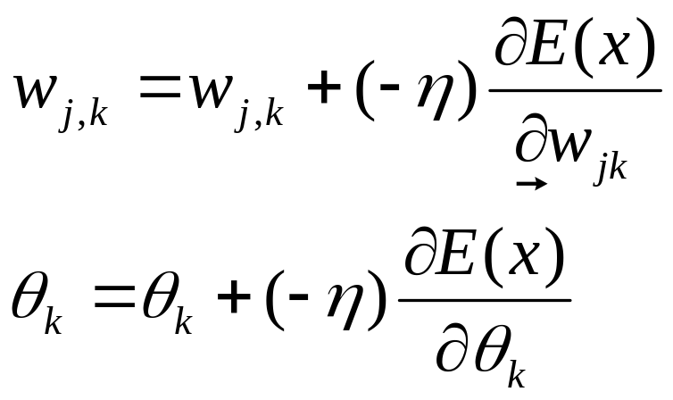
ANN Training
Update weights and thresholds using
  Weights
  Bias
  η is a possibly time-dependent factor that should prevent overcorrection

Slide 35
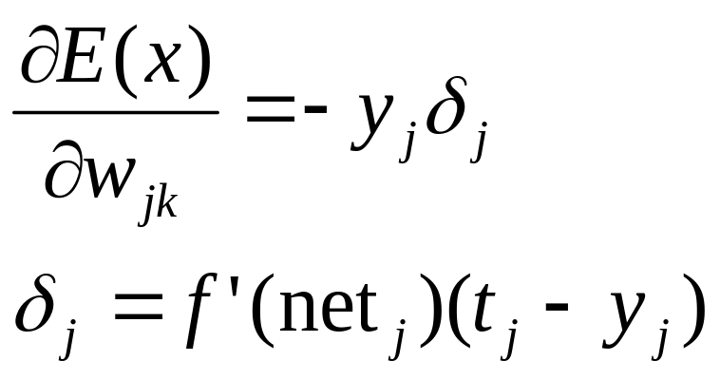
ANN Training
Using a sigmoid function, we get
  Logistics function ϕ has derivative ϕ’(t) = ϕ(t)(1- ϕ(t))

Slide 36
ANN Training Example
Start out with random, small weights
x1 | x2 | y
0 | 0 | 0.687349
0 | 1 | 0.667459
1 | 0 | 0.698070
1 | 1 | 0.676727
-0,5
0
2
0.1
-0.5
4
1
1
3
-0.5
1
-1
-0.5
1
Bias

Slide 37
ANN Training Example
x1 | x2 | y | Error
0 | 0 | 0.69 | 0.472448
0 | 1 | 0.67 | 0.110583
1 | 0 | 0.70 | 0.0911618
1 | 1 | 0.68 | 0.457959
0
-0,5
2
0.1
-0.5
1
4
1
3
-0.5
1
-1
-0.5
1
Bias
Average Error is 0.283038

Slide 38
ANN Training Example
x1 | x2 | y | Error
0 | 0 | 0.69 | 0.472448
0 | 1 | 0.67 | 0.110583
1 | 0 | 0.70 | 0.0911618
1 | 1 | 0.68 | 0.457959
0
-0,5
2
0.1
-0.5
1
4
1
3
-0.5
1
-1
-0.5
1
Bias
Average Error is 0.283038

Slide 39
ANN Training Example
Calculate the derivative of the error with respect to the weights and bias into the output layer neurons

Slide 40
ANN Training Example
New weights going into node 4
We do this for all training inputs, then average out the changes
net₄ is the weighted sum of input going into neuron 4:
net₄(0,0)= 0.787754
net4(0,1)= 0.696717
net4(1,0)= 0.838124
net4(1,1)= 0.73877
0
-0,5
2
0.1
-0.5
1
4
1
3
-0.5
1
-1
-0.5
1
Bias

Slide 41
ANN Training Example
New weights going into node 4
We calculate the derivative of the activation function at the point given by the net-input.
Recall our cool formula
ϕ’(t) = ϕ(t)(1- ϕ(t))
ϕ’( net₄(0,0)) = ϕ’( 0.787754) = 0.214900
ϕ’( net₄(0,1)) = ϕ’( 0.696717) = 0.221957
ϕ’( net₄(1,0)) = ϕ’( 0.838124) = 0.210768
ϕ’( net₄(1,1)) = ϕ’( 0.738770) = 0.218768
0
-0,5
2
0.1
-0.5
1
4
1
3
-0.5
1
-1
-0.5
1
Bias

Slide 42
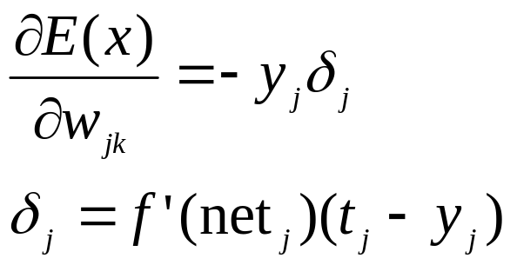
ANN Training Example
New weights going into node 4
We now obtain δ values for each input separately:
Input 0,0:
δ₄= ϕ’( net₄(0,0)) *(0-y₄(0,0)) = -0.152928
Input 0,1:
δ₄= ϕ’( net4(0,1)) *(1-y₄(0,1)) = 0.0682324
Input 1,0:
δ₄= ϕ’( net₄(1,0)) *(1-y₄(1,0)) = 0.0593889
Input 1,1:
δ₄= ϕ’( net₄(1,1)) *(0-y₄(1,1)) = -0.153776
Average: δ₄ = -0.0447706
0
-0,5
2
0.1
-0.5
1
4
1
3
-0.5
1
-1
-0.5
1
Bias

Slide 43
ANN Training Example
New weights going into node 4
Average: δ₄ = -0.0447706
We can now update the weights going into node 4:
Let’s call: E_{ji} the derivative of the error function with respect to the weight going from neuron i into neuron j.
We do this for every possible input:
E_{4,2} = - output(neuron(2)* δ₄
For (0,0): E_{4,2} = 0.0577366
For (0,1): E_{4,2} = -0.0424719
For(1,0): E_{4,2} = -0.0159721
For(1,1): E_{4,2} = 0.0768878
Average is 0.0190451
0
-0,5
2
0.1
-0.5
1
4
1
3
-0.5
1
-1
-0.5
1
Bias

Slide 44
ANN Training Example
0
-0,5
2
0.1
-0.5
1
4
New weight from 2 to 4 is now going to be 0.1190451.
1
3
-0.5
1
-1
-0.5
1
Bias

Slide 45
ANN Training Example
New weights going into node 4
For (0,0): E_{4,3} = 0.0411287
For (0,1): E_{4,3} = -0.0341162
For(1,0): E_{4,3} = -0.0108341
For(1,1): E_{4,3} = 0.0580565
Average is 0.0135588
New weight is -0.486441
0
-0,5
2
0.1
-0.5
1
4
1
3
-0.5
1
-1
-0.5
1
Bias

Slide 46
ANN Training Example
New weights going into node 4:
We also need to change the bias node
For (0,0): E_{4,B} = 0.0411287
For (0,1): E_{4,B} = -0.0341162
For(1,0): E_{4,B} = -0.0108341
For(1,1): E_{4,B} = 0.0580565
Average is 0.0447706
New weight is 1.0447706
0
-0,5
2
0.1
-0.5
1
4
1
3
-0.5
1
-1
-0.5
1
Bias

Slide 47
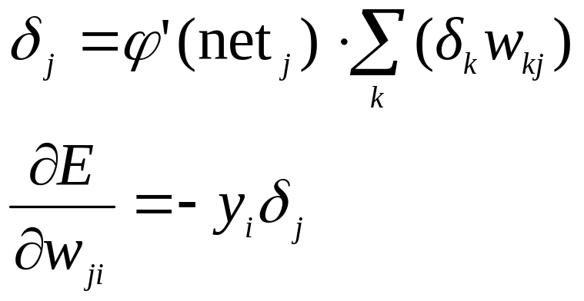
ANN Training Example
We now have adjusted all the weights into the output layer.
Next, we adjust the hidden layer
The target output is given by the delta values of the output layer
More formally:
  Assume that j is a hidden neuron
  Assume that δ_{k} is the delta-value for an output neuron k.
  While the example has only one output neuron, most ANN have more. When we sum over k, this means summing over all output neurons.
  w_{kj} is the weight from neuron j into neuron k

Slide 48
ANN Training Example
We now calculate the updates to the weights of neuron 2.
First, we calculate the net-input into 2.
This is really simple because it is just a linear functions of the arguments x₁ and x₂
net₂ = -0.5 x₁ + x2 - 0.5
We obtain
δ₂ (0,0) = - 0.00359387
δ₂(0,1) = 0.00160349
δ₂(1,0) = 0.00116766
δ₂(1,1) = - 0.00384439
0
-0,5
2
0.1
-0.5
1
4
1
3
-0.5
1
-1
-0.5
1
Bias

Slide 49
ANN Training Example
Call E₂₀ the derivative of E with respect to w₂₀. We use the output activation for the neurons in the previous layer (which happens to be the input layer)
E₂₀ (0,0) = - ϕ(0)⋅δ₂ (0,0) = 0.00179694
E₂₀(0,1) = 0.00179694
E₂₀(1,0) = -0.000853626
E₂₀(1,1) = 0.00281047
The average is 0.00073801 and the new weight is -0.499262
0
-0,5
2
0.1
-0.5
1
4
1
3
-0.5
1
-1
-0.5
1
Bias

Slide 50
ANN Training Example
Call E₂₁ the derivative of E with respect to w₂₁. We use the output activation for the neurons in the previous layer (which happens to be the input layer)
E₂₁ (0,0) = - ϕ(1)⋅δ₂ (0,0) = 0.00179694
E₂₁(0,1) = -0.00117224
E₂₁(1,0) = -0.000583829
E₂₁(1,1) = 0.00281047
The average is 0.000712835 and the new weight is 1.00071
0
-0,5
2
0.1
-0.5
1
4
1
3
-0.5
1
-1
-0.5
1
Bias

Slide 51
ANN Training Example
Call E_{2B} the derivative of E with respect to w_{2B}. Bias output is always -0.5
E_{2B} (0,0) = - -0.5 ⋅δ₂ (0,0) = 0.00179694
E_{2B}(0,1) = -0.00117224
E_{2B}(1,0) = -0.000583829
E_{2B}(1,1) = 0.00281047
The average is 0.00058339 and the new weight is -0.499417
0
-0,5
2
0.1
-0.5
1
4
1
3
-0.5
1
-1
-0.5
1
Bias

Slide 52
ANN Training Example
We now calculate the updates to the weights of neuron 3.
…
0
-0,5
2
0.1
-0.5
1
4
1
3
-0.5
1
-1
-0.5
1
Bias

Slide 53
ANN Training
ANN Back-propagation is an empirical algorithm

Slide 54
ANN Training
XOR is too simple an example, since quality of ANN is measured on a finite sets of inputs.
More relevant are ANN that are trained on a training set and unleashed on real data

Slide 55
ANN Training
Need to measure effectiveness of training
  Need training sets
  Need test sets.
There can be no interaction between test sets and training sets.
  Example of a Mistake:
      Train ANN on training set.
      Test ANN on test set.
      Results are poor.
      Go back to training ANN.
    After this, there is no assurance that ANN will work well in practice.
      In a subtle way, the test set has become part of the training set.

Slide 56
ANN Training
Convergence
  ANN back propagation uses gradient decent.
  Naïve implementations can
    overcorrect weights
    undercorrect weights
  In either case, convergence can be poor
Stuck in the wrong place
  ANN starts with random weights and improves them
  If improvement stops, we stop algorithm
  No guarantee that we found the best set of weights
  Could be stuck in a local minimum

Slide 57
ANN Training
Overtraining
  An ANN can be made to work too well on a training set
  But loose performance on test sets
Training set
Test set
Performance
Training time

Slide 58
ANN Training
Overtraining
  Assume we want to separate the red from the green dots.
  Eventually, the network will learn to do well in the training case
  But have learnt only the particularities of our training set

Slide 59
ANN Training
Overtraining

Slide 60
ANN Training
Improving Convergence
  Many Operations Research Tools apply
    Simulated annealing
    Sophisticated gradient descent

Slide 61
ANN Design
ANN is a largely empirical study
  “Seems to work in almost all cases that we know about”
Known to be statistical pattern analysis

Slide 62
ANN Design
Number of layers
  Apparently, three layers is almost always good enough and better than four layers.
  Also: fewer layers are faster in execution and training
How many hidden nodes?
  Many hidden nodes allow to learn more complicated patterns
  Because of overtraining, almost always best to set the number of hidden nodes too low and then increase their numbers.

Slide 63
ANN Design
Interpreting Output
  ANN’s output neurons do not give binary values.
    Good or bad
    Need to define what is an accept.
  Can indicate n degrees of certainty with n-1 output neurons.
    Number of firing output neurons is degree of certainty

Slide 64
ANN Applications
Pattern recognition
  Network attacks
  Breast cancer
  …
  handwriting recognition
Pattern completion
Auto-association
  ANN trained to reproduce input as output
    Noise reduction
    Compression
    Finding anomalies
Time Series Completion

Slide 65
ANN Future
ANNs can do some things really well
They lack in structure found in most natural neural networks

Slide 66
Pseudo-Code
phi – activation function
phid – derivative of activation function

Slide 67
Pseudo-Code
Forward Propagation:
  Input nodes i, given input x_{i}:
    foreach inputnode i
    output_{i} = x_{i}
  Hidden layer nodes j
    foreach hiddenneuron j
    output_{j} = ∑_{i} phi(w_{ji}⋅output_{i})
  Output layer neurons k
    foreach outputneuron k
    output_{k} = ∑_{k} phi(w_{kj}⋅output_{j})

Slide 68
Pseudo-Code
ActivateLayer(input,output)
foreach i inputneuron
calculate output_{i}
foreach j hiddenneuron
calculate output_{j}
foreach k hiddenneuron
calculate output_{k}
output = {output_{k}}

Slide 69
Pseudo-Code
Output Error
Error() {
foreach input in InputSet
Error_{input} = ∑_{k output neuron} (target_{k}-output_{k})²
return Average(Error_{input},InputSet)

Slide 70
Pseudo-Code
Gradient Calculation
  We calculate the gradient of the error with respect to a given weight w_{kj}.
  The gradient is the average of the gradients for all inputs.
  Calculation proceeds from the output layer to the hidden layer

Slide 71
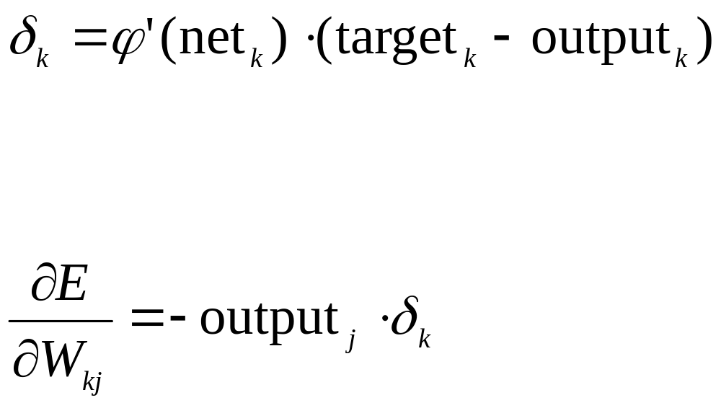
Pseudo-Code
For each output neuron k calculate:
For each output neuron k calculate and hidden layer neuron j calculate:

Slide 72
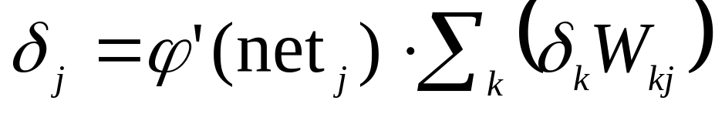
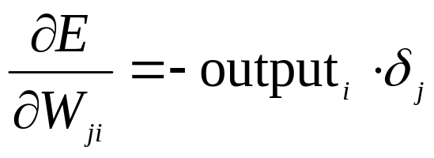
Pseudo-Code
For each hidden neuron j calculate:
For each hidden neuron j and each input neuron i calculate:

Slide 73
Pseudo-Code
These calculations were done for a single input.
Now calculate the average gradient over all inputs (and for all weights).
You also need to calculate the gradients for the bias weights and average them.

Slide 74
Pseudo-Code
Naïve back-propagation code:
  Initialize weights to a small random value (between -1 and 1)
  For a maximum number of iterations do
    Calculate average error for all input. If error is smaller than tolerance, exit.
    For each input, calculate the gradients for all weights, including bias weights and average them.
    If length of gradient vector is smaller than a small value, then stop.
    Otherwise:
      Modify all weights by adding a negative multiple of the gradient to the weights.

Slide 75
Pseudo-Code
This naïve algorithm has problems with convergence and should only be used for toy problems.

Slide 76
ANN Training Example 2
Start out with random, small weights
1
Node 0: x₀
Node 1: x₁
Node 2: o₂ = ϕ(x₀ + x₁ -0.5)
Node 3: o₃ = ϕ(0.5 x₁ -1)
Node 4: o₄ = ϕ(0.3 o₂ – 0.7 o₃ + 1)
0
2
0.3
0
4
1
1
3
-0.7
0.5
-1
-0.5
1
Bias

Slide 77
ANN Training Example 2
Calculate outputs
1
x1 | x2 | y=o₄
0 | 0 | 0.7160
0 | 1 | 0.7155
1 | 0 | 0.7308
1 | 1 | 0.7273
0
2
0.3
0
4
1
1
3
-0.7
0.5
-1
-0.5
1
Bias

Slide 78
ANN Training Example 2
Calculate average error to be E = 0.14939
0
1
2
0.3
x₀ | x₁ | y | t | E=(y-t)²/2
0 | 0 | 0.7160 | 0 | 0.2564
0 | 1 | 0.7155 | 1 | 0.0405
1 | 0 | 0.7308 | 1 | 0.0362
1 | 1 | 0.7273 | 0 | 0.264487
0
1
4
1
0.5
3
-0.7
-1
-0.5
1
Bias

Slide 79
ANN Training Example 2
Calculate the change for node 4
0
1
2
0.3
0
1
4
1
3
-0.7
0.5
-1
-0.5
1
Bias
Need to calculate net₄, the weighted input of all input into node 4
net₄(x₀,x₁) = 0.3 o₂(x₀,x₁) – 0.7 o₃(x0,x1) + 1
net₄ = (net₄(0,0) + net₄(0,1) + net₄(1,0) + net₄(1,1))/4
This gives 0.956734

Slide 80
ANN Training Example 2
Calculate the change for node 4
0
1
2
0.3
0
1
4
1
3
-0.7
0.5
-1
-0.5
1
Bias
We now calculate
δ₄(0,0) = ϕ’(net₄(0,0)(0 - o₄(0,0)) = - 0.14588
δ₄(0,1) = ϕ’(net4(0,1)(1 - o4(0,1)) = 0.05790
δ₄(1,1) = ϕ’(net4(1,0)(0 - o4(1,0)) = 0.05297
δ₄(1,1) = ϕ’(net4(1,1)(0 - o4(1,1)) = -0.14425
On average δ₄ = -0.044741

Slide 81
ANN Training Example 2
Calculate the change for node 4
0
1
2
0.3
0
1
4
1
3
-0.7
0.5
-1
-0.5
1
δ₄ = -0.044741
We can now update the weights for node 4
E_{4,2}(0,0) = -o₂(0,0)* δ₄ =0.01689
E_{4,2}(0,1) = -o₂(0,1)* δ₄ = 0.02785
E_{4,2}(1,0) = -o₂(1,0)* δ₄ = 0.02785
E_{4,2}(0,0) = -o₂(0,0)* δ₄ =0.03658
with average 0.00708
Bias

Slide 82
ANN Training Example 2
Calculate the change for node 4
0
1
2
0.3
0
1
4
1
3
-0.7
0.5
-1
-0.5
1
Bias
E_{4,2} = 0.00708
Therefore, new weight w₄₂ is 0.2993

